Slide 1

Final Project
Anna Day, John Brenton Arney, Eva Hawkins

Slide 2
Meet the Team
Pictures

Slide 3
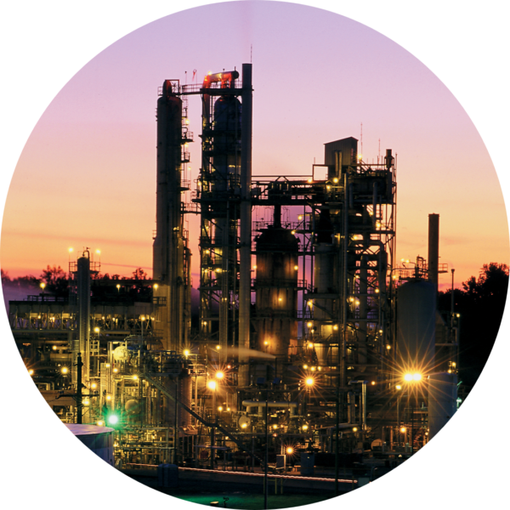

T0pic
N-Butane Recycle Build Up

Slide 4
Reason why topic was chosen
This topic interest us
Availability of sources
Shows Machine Learning potential
Is challenging
Is manageable
Is significant
Is great interview preparation

Slide 5
N-Butane Recycle Build Up
•Utilize principal component analysis, and neural networks to develop machine learning methods to predict probably of N-Butane build up.
•Input RX, Tower A, Tower B, and Tower C data, twice daily N-Butane samples for qualifier
•Outputs are probability percentage that we are building or purging N-Butane.
•No side-draw for N-Butane at Tower A, RVP penalty for dropping i-Butane is severe.
•Current procedure is relying on twice daily samples.
•Operations are blind in-between samples, as is efforts to measure N-Butane balance
•Operations have noticed correlations with Tower A overhead temperature ( >135F) as early warning of N-C4 build up.
•ML Model goal is to input all tower and reactor data and predict the statistical probability that we are in a “N-Butane Build-Up” mode

Slide 6
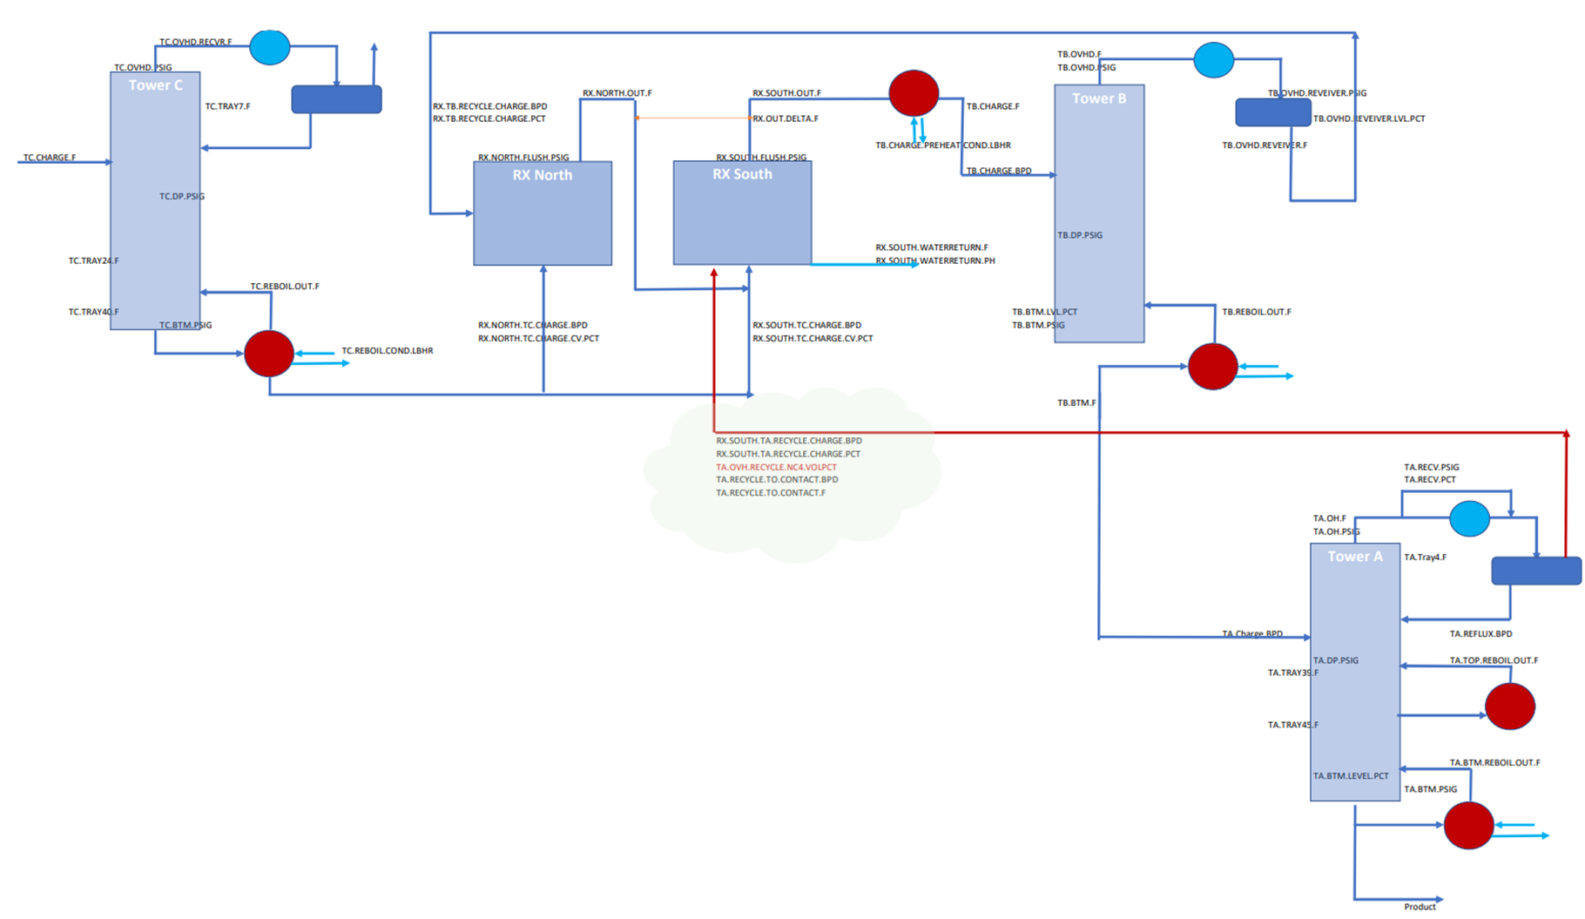
Process Block Flow

Slide 7
Software
Jupyter Notebook
Quick Data Base Diagram
Postgres pgadmin

Slide 8
Content
Utilize plant data from multiple unit assets to develop machine learning methods to predict "live" volume percentage of N-Butane build up in Tower A recycle line to Reactor.
Excess N-Butane accumulates in the Tower A recycle stream and essentially dilutes the isobutane content resulting in unfavorable reaction conditions, effects reaction quality, and I:O ratio (Isobutane : Olefin). Lab sample frequency periods being too far apart along with subtle N-Butane accumulation manifests in a way that is difficult for humans to recognize quickly or effectively. However, N-Butane must be removed in such a way that there is a balance on the reaction, separation section, and in the product stream.
The more N-Butane that leaves the unit, the more isobutane also leaves the unit, therefore a balance must take place in the unit between the two species to keep N-Butane manageable while limiting Isobutane loses.
The source data comes from individual asset data files pulled from the site process information historian in the form of CSV files. This data was pulled over a 9.5 year span and contains over 1.2 million individual data points before the ETL process was began. A block flow diagram of the process is included in Figure #1 below, along with individual sensor datapoints in their respective locations.
1

Slide 9
Provisional Machine Learning Model
An outline of machine learning models is provided below:
Tower A: (Linear Regression, Logistic Regression, Random Forrest, and Support Vector Machine)
Tower B: (Linear Regression, Logistic Regression, Random Forrest, and Support Vector Machine)
Reactor: (Linear Regression, Logistic Regression, Random Forrest, and Support Vector Machine)
-- Note: A copy of the Model Testing Branch's "Model" folder has been uploaded to the Main Branch.
Provisional Machine Learning Model
Twelve (12) provisional machine learning models have been created and published on the Model Testing Branch. These models currently are used as stand-ins for the final machine learning model and have helped the team determine the best methods for cleaning and determining feature importances on the raw datasets for Tower A, Tower B, and the Reactor. These provisional models have also helped guide the descision making in selecting the best model library to use for the final project deliverable.

Slide 10
Description of the analysis phase of the project
-- Note: A copy of the SQL Query Code can be found in the "SQL Code" folder in the Main Branch -- Note: A copy of the pythod code that exported the SQL table can be found in the "SQL Extact" filer in the Main Branch. -- Note: A copy of the final model and unselected models can be found in the "Final Models" folder in the Main Branch

Slide 11
Explanation of Model Choice: including limitations and benefits
SK Learn's train_test_split function was used to split the model into training and testing arrays, using a random state of zero. The The model testing performance, when used to predict the X_test split was quite robust, though not perfect. The group had an opportunity to showcase the linear regression models output to the companies process unit subject matter expert, who was quite pleased with the performace. The following performace metric results were gathered based on the X_test predictions.
After testing the cleaned and joined data through the following models, Linear Regression, Logistic Regression, Random Forrest, and Support Vector Machine, the model selected was SK Learn's Linear Regression model. This model was chosen because the output (y_predict) was more acurate, and an actual representation of the N-Butane Vol%, rather than a binary grouping prediction. This number based prediction proves more valuable in real-world operations of the process unit in question.

Slide 12
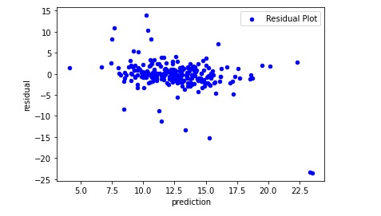
Residual Plot

Slide 13
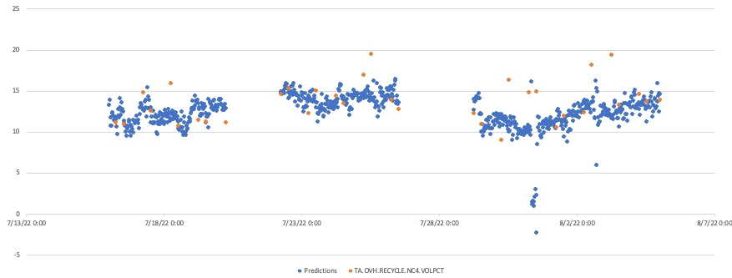
Real Time Model Performance

Slide 14
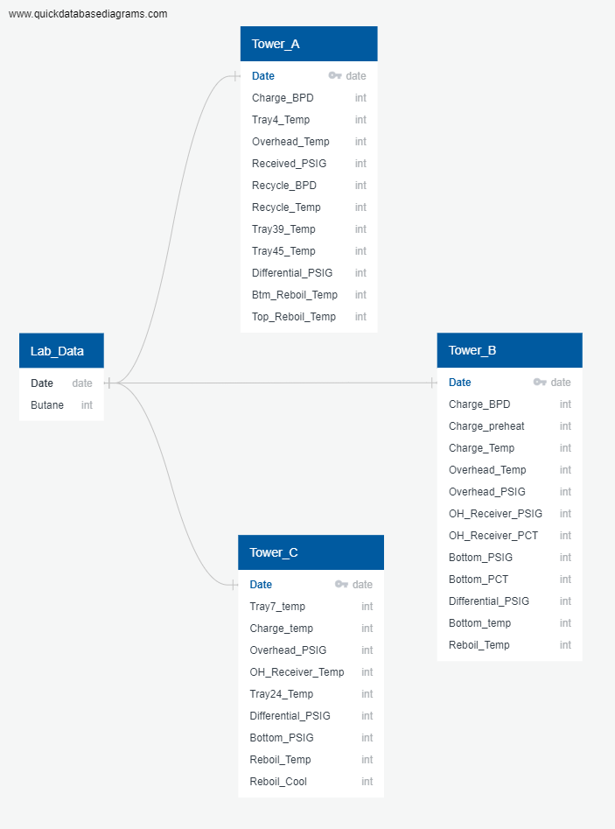
SQL Diagram

Slide 15
EDA Process
The exploratory data analysis process began with checking the raw data for non-numerical values. We found that there were a few text strings: "Bad", "Bad Input", "Error", and "I/O Timeout". All values across the datasets were object types, and we wanted to convert those to float types. The text strings were preventing the whole dataset from being converted with minimal code. So, we replaced these text strings with NaN values, and dropped them. Then we did a full conversion, and generated summary statistics to get an idea of the spread of the data values. We noted multiple values that made no sense (like percent values that fell outside 0-100) and marked them for removal.
We also went ahead and calculated some feature importances, feature coefficients, and correlations to understand the relationships of the features among each other and with different model types.

Slide 16
EDA Process
During the EDA process we also saw that some datetimes were strange. Data was collected at 2 times every day: hour 6 and hour 13, and never at any minute besides 00. A significant chunk of the data was collected at arbitrary datetimes, and this was concerning. After some discussion, we realized that the dates that were strange fell under a period of turnaround for the plant, meaning that the plant itself was shut down and all the data collected in the period was invalid. We marked those datetimes for removal during the data cleaning process.

Slide 17
Conclusion
In conclusion, there is certainly limitations to the model. While it does not predict the N-Butane Vol% exactly, it does seem to trend the general direction of the N-Butane Vol%, and generally predicts this figure within 2-5 Vol% points. In fact, the larger descrepancies between actual and predicted seem to occur when certain temperature and flow measurments were zero, which indicates either process upset or instument error. By only allowing the prediction to occur when all input data streams are within normal operating conditions, performance is likly to improve.

Slide 18
Questions?

Slide 19
References

Slide 20
Thank You

